Slide 1
COUNTRY ENGAGEMENT PHASES & ROUTE TO MARKET

Slide 2
COUNTRY ENGAGEMENT PROCESS
2
COUNTRIES ARE HERE:
High Level Framework Shared
Competitor Analysis
Country Review
Alignment
Solution Design
LetsGo Solution Designed
AS-IS / TO-BE Finalised
System Functionality
Project Initiated
Review and Optimise
End User Orientation
Adoption
Re-Launch - Scale
Launch Pilot – With Support
Launch
Monthly Working Sessions
Post Pilot Review
2
COUNTRIES ARE HERE:

Slide 3
ROUTE TO MARKET: Pilot Phases
Step by step process to establish country specific – LetsGo ALL-IN-1 solution
Customer Value Proposition
Create Customer Value Proposition
Opportunity to test different messages for results
All staff to create their own LetsGo (put themselves in the customers shoes)
Internal training on LetsGo
Awareness and Understanding
Targeted SMS campaigns to existing customers
Targeted telemarketing campaigns to existing customers
Conversion
Document Customer Journey
Review results for customer behaviour, experience, functionality of LetsGo and revise
Scale LetsGo All-in-1
Review

Slide 4
LetsGo – Go To Market
The success of LetsGo is underpinned by driving the appropriate “all-in-1” value proposition to the customer in a 3-pronged cyclical process:
Awareness: the customer becomes aware of LetsGo all-in-1 and understands the value from the solution (Can pay or get paid; Save or Borrow – all-in-1)
Conversion: customer opens and is an active user of LetsGo
Incremental adoption: Customer uses more features of LetsGo all-in-1 and also encourages family & friends to sign up
Awareness & understanding
Conversion & use
Incremental Adoption
How | Awareness & Understanding | Conversion & Use | Incremental Adoption
 | Sales team training
 | Internal staff training & account opening (for feedback)
 | Direct Marketing SMS; Email Promotions & incentives
 | Activations & roadshows
 |  | Community immersions
 | Branding & retail visibility
 | Branded collateral & apparel
 |  | Media: mass & social

Slide 5
Overview of Deliverables
Pilot
Scale
CEO Letter
Cheat Sheet
CEO Presentation
Sales html toolkit
INTERNAL
Training tools
Tent Card
FAQ’s
FRAMEWORK
Staff pocket book
Printed Manual
Sales Training Deck
Motion Graphic
Through the line
Posters/flyers/tshirts
Pilot
(Call to Action)
Below the line
SMS, Promotions
EXTERNAL
It’s Possible campaign theme
Go to market tools
Brand Guide
Above the line
Radio / Mass Media
Scale
(Call to Action)
Through the line
Social Media
Below the line
Activations

Slide 6
LetsGo All-in-1 Logo

Slide 7
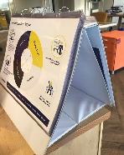
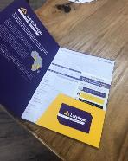
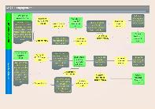
Training | Sales team, Customer Facing team, All staff
All staff to understand LetsGo all-in-1 and what it means for the customer.
To be carried out at least 3 weeks before launch of LetsGo All-in-1 in-country
Sales & customer facing team having the most robust and drilling down to address specific customer areas – upselling & conflict resolution.
Training materials which also serve as solution tools for sales & customer facing include:
What | Sales Team | Customer Facing (incl call centre) | All other Staff
 | Sales Presenter & folder
 | “Cheat sheet” (quick reference guide) incl customer quick reference document
 | FAQs | Detailed FAQs
 | Information flyers (to give out to Customers)
 | Account opening forms
 |  | SMS & Call scripts/guide

Slide 8
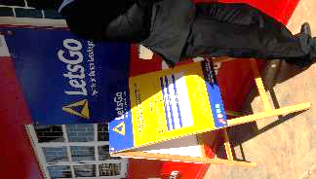
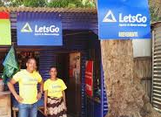
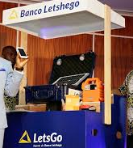
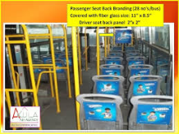
Branding & Retail Visibility
The branding & retail visibility elements serve two purposes: brand top of mind and as demarcation of where one can interact with LetsGo
Minimum standard materials to be developed include:
 | Where
What | Branches | Agents | Partners
 | Signage boards (large) | Signage boards (small)
 |  | Parasols | Canopy cover
 | Outdoor stands | A-boards & Flags; Windvane
 | Printed material incl: posters, pyramid tent card, flyers , account opening forms
 | Branded materials incl pens, notebooks, lanyards
 | Branded apparel incl t-shirts, bucket hats, khanga/kitenge, drapery (agents only)
Other Items to be included: branding of PSVs (e.g. internal); Market signage; directional signage; wall branding; bus shelters; banners

Slide 9
Direct Marketing
Reaching out to sub-segments of the customer base to test or up-sell LetsGo at different intervals. Main mode us through internal resources – SMS, Emails, Direct calling
Mode
SMS
Phone call
Email
Agent visits
Letter
Corporate visits
Activity
Test & Learn
Segmented promotion
Acquisition & Retention
Cross-selling
Customer Satisfaction survey
Motivation
Relationship enhancing
Individual customers
Agents
Corporate Customers
Direct marketing initiatives are continuous and will be based on tactical campaigns to acquire customers – incentivize their usage and retain them as active LetsGo account users
Direct marketing will also be a source for data collection esp around customer satisfaction.

Slide 10
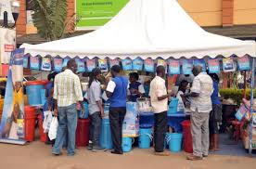
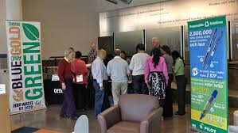
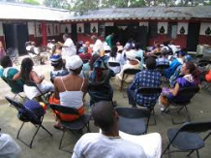
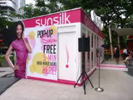
Activations & Immersions
Use of market & corporate activations, road-shows and community immersions as the interactive process with individuals, communities and/or corporates within the settings & environment in which they are likely to be more relaxed, comfortable & engaged to promote adoption and use of LetsGo
Individuals | Agents/3rd parties | Corporates
Market (day) activations & shopping arcade set up
 |  | Office road-show
Community immersion (e.g. community meetings; church events; fund-raising events; local soccer matches; school meetings etc)
Door2Door (foot soldiers)
Pop-up stalls (e.g. salons for women; board games for men)

Slide 11
Mass & Social Media
Use of appropriate and relevant mass and limited social media to communicate awareness of the LetsGo account and the value proposition to the different segments of customers.
Segmented & tactical in approach & execution
Individuals | Agents/3rd parties | Corporates
Radio: spots, intro & outro boards (sponsorships); interactive (edutainment) intervals
Newspaper: more corporate positioning
Social media promoted ads and financial wellbeing messaging |  | Social media promoted ads and financial wellbeing messaging
Explore unique opportunities e.g. PSV music; in-store radio &
Develop infographics, visuals & audio clips that can be shared on social networking groups

Slide 12
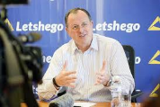
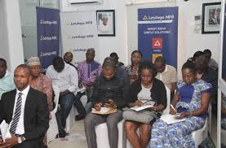
PR, Corporate Comms & Stakeholder Engagement
Ensuring all relevant stakeholders receive accurate, appropriate and timely information in order to get buy-in & support, as well as alignment on the LetsGo agenda.
 | Who
What | Internal (staff) | Partners | Media & Interested parties | Regulatory, Governments, Board Members
 | Information emailer & relevant toolkits or pocket books |  | Press release | Requisite formal notification doc
 | Town hall | Media briefing & event
 |  |  |  | Scheduled meetings
 |  | Publication bookings (Information sharing + thought leadership)
 | Appropriate & relevant communication (incl digital & radio)

